Slide 1
Linear Regression

Slide 2
Introduction
Relation between two variable
Eg: Based on year of experience, salary will be fixed
In this year of experience is independent variable (X)
Salary is a dependent variable (y)
There will be a correlation between two variables

Slide 3
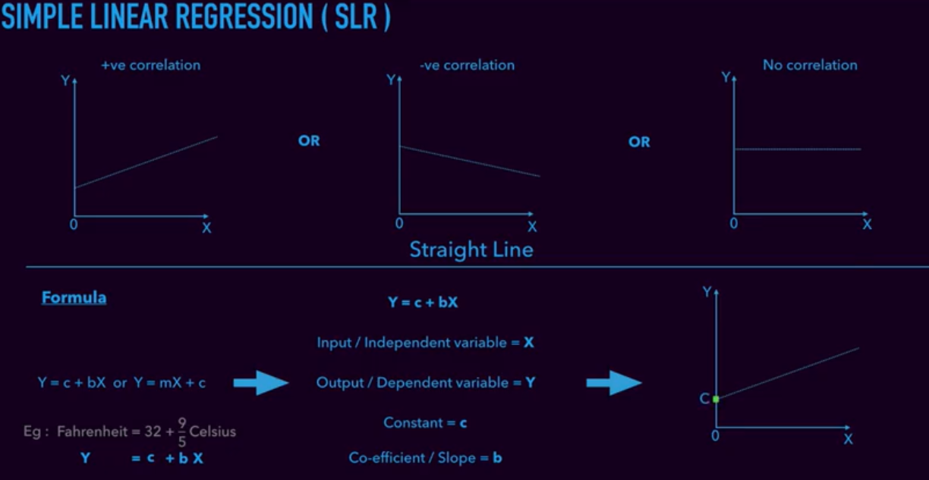
Type of correlation

Slide 4
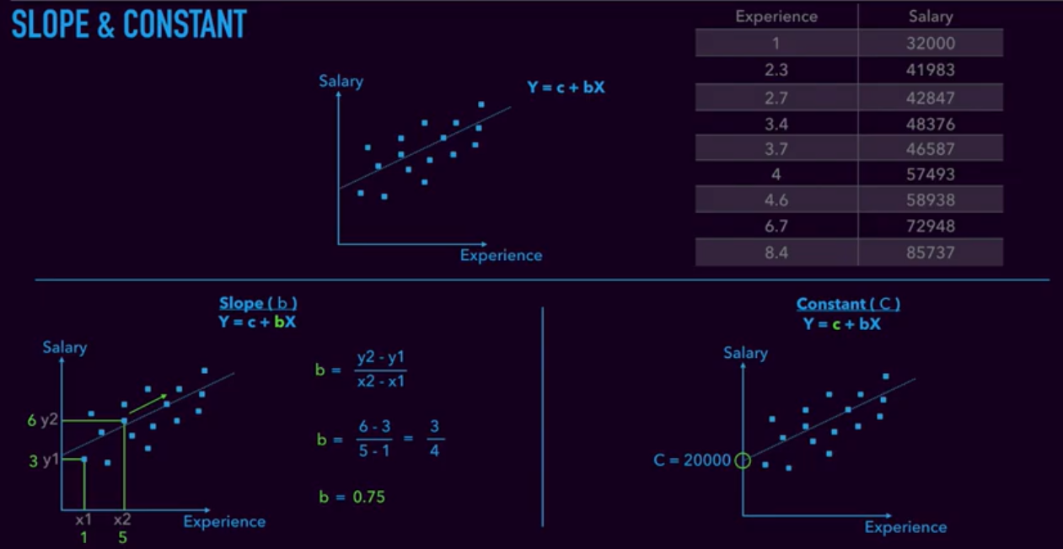

Slide 5
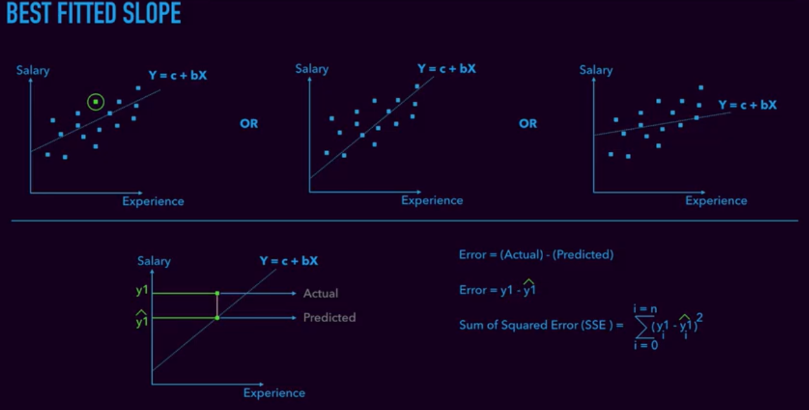

Slide 6
Linear Regression 2
Business problem statement:
I have got a real dataset of 10,000 rows, with two variables “HEIGHT” and “WEIGHT”. Using this dataset I would like to build a model that predicts a weight of a person by shared the height information

Slide 7
Step by step approach
Import required library
Import dataset
Split data as dependent and independent variable
Check for missing values(if any) and if so fix it
Optional: check the missing value is fixed in array
Split training and test data
Build the model with test data and predict using training data
Visualize the output graph
Fun time: Input your height and check the model output

Slide 8
